Slide 1
Sprint 2 Presentation

Slide 2
Agenda
Introduction -Team Roles & Responsibilities -Feedback -Product Description -Team Working Agreement -Personas -MVP
Technical -Technologies Used -Algorithms -Diagrams
Sprint 2 Recap
Product Backlog
Sprint Summary -Sprint 1 -Sprint 2
Sprint 2 Backlog
Metrics -Team Velocity -Burndown Charts -Ratios
Sprint 2 Demo Slides

Slide 3
Team Roles & Responsibilities
Charles Varga - DevOps/Tech Architect
Tara Edney - Frontend
Anndeen Daley - Data Engineer/Database
Younes Roumila - Backend
Bella Gerken - AI/NLP Integration
James Simpson - PO/SCRUM Master
QA/QC 1 - Charles Varga
QA/QC 2 - James Simpson

Slide 4
Feedback
-Extensive work on Wiki (from 1am meeting)

Slide 5
Project Description
The Intelligent Academic Path Optimizer is an application which will streamline the academic advising workflow. The app is designed to use AI to facilitate decision making when generating a conflict-free academic schedule for students. By utilizing the Constraint Satisfaction Problem algorithms and predictive modeling, the application will dynamically output the most efficient path to graduation based on specific student parameters.
Notes:
Tara

Slide 6
Team Working Agreement
Decision Making – Consensus, voting when necessary. Most decisions thus far have been reached by consensus, and the only vote that was taken was for the Project Logo, which was unanimous anyway.
Team meetings – Decided using When2Meet on a weekly basis. Team has varying schedules week on week, so this is the best as opposed to a set meeting time.
Team keeps team accountable. We will use group accountability and help remind each other of deadlines.
Notes:
James

Slide 7
Personas
Academic Advisor: Isabelle Johnson, 42 · Pace University
Problem
Manually verifies prereqs and builds schedules for 100+ students
Changing requirements risk graduation delays
Goals
Accurate prereq and degree checks
Automated scheduling
Earlier risk flags
More time to help students
How IAPO Helps
Generates valid pathways so she can focus on mentorship
Graduate Student: William Court, 24 · CS Major
Problem
Confused about prereqs and availability each semester
Unclear requirements delay graduation and raise costs
Goals
Fastest path to graduate
"What-if" planning before registering
Balanced schedule
Steady GPA
How IAPO Helps
Builds an optimized schedule from his credits, goal date, and load
Dept. Administrator: Michael Rodriguez, 52 · CS Chair
Problem
Little visibility into which prereqs cause delays
Relies on manual progress reviews
Goals
Spot bottlenecks
Track student progression
Support data-driven decisions
Raise grad rates
How IAPO Helps
Surfaces bottlenecks from degree plans to guide curriculum planning
Notes:
Anndeen & Bella

Slide 8
MVP
A user-friendly interface in which the user can interact with the AI tied to the app to receive feedback based on the input
A text input in which students can specify their particular academic needs to the AI
A clearly visible feedback mechanism which users can utilize to inform developers about the AI, particularly in cases when it generates incorrect information or hallucinates
A means for users to select the major that they are pursuing and at which level, be it undergraduate or graduate
Output from the AI which consists of the classes that the students should take based on specified major as well as any text input for specific academic needs in the prompt, and in which semesters these students should take specific classes
Notes:
Charles & Tara

Slide 9
Technologies
Frontend
(React Website)
Figma
React JS
Native CSS
Email JS
Backend
(Web Server)
Python 3.12 w. FastAPI
Gemini API (AI Chat)
AWS DynamoDB + S3 (Accounts)
Web Hosting
Github Pages (Frontend)
PythonAnywhere (Web Server)
AWS (User Storage)
Gemini (AI Server)
Notes:
Younnes

Slide 10
Algorithms
Input form fields + free text + optional transcript
Stage 1: AI Extraction Receives student inputs, decodes transcript, sends structured prompt to Gemini API, returns validated student profile (completed courses, degree level, constraints, preferences)
Stage 2: AI Catalog Reasoning Loads full course catalog from database, maps free text to scheduling constraints, scores electives by interest/career fit, checks prerequisite eligibility, calculates remaining degree requirements, drafts candidate plans
Stage 3: CSP Solver Validates AI-proposed plans against live section data, resolves conflicts, optimizes final schedule
Output A personalized, recommended course schedule
Notes:
Bella

Slide 11
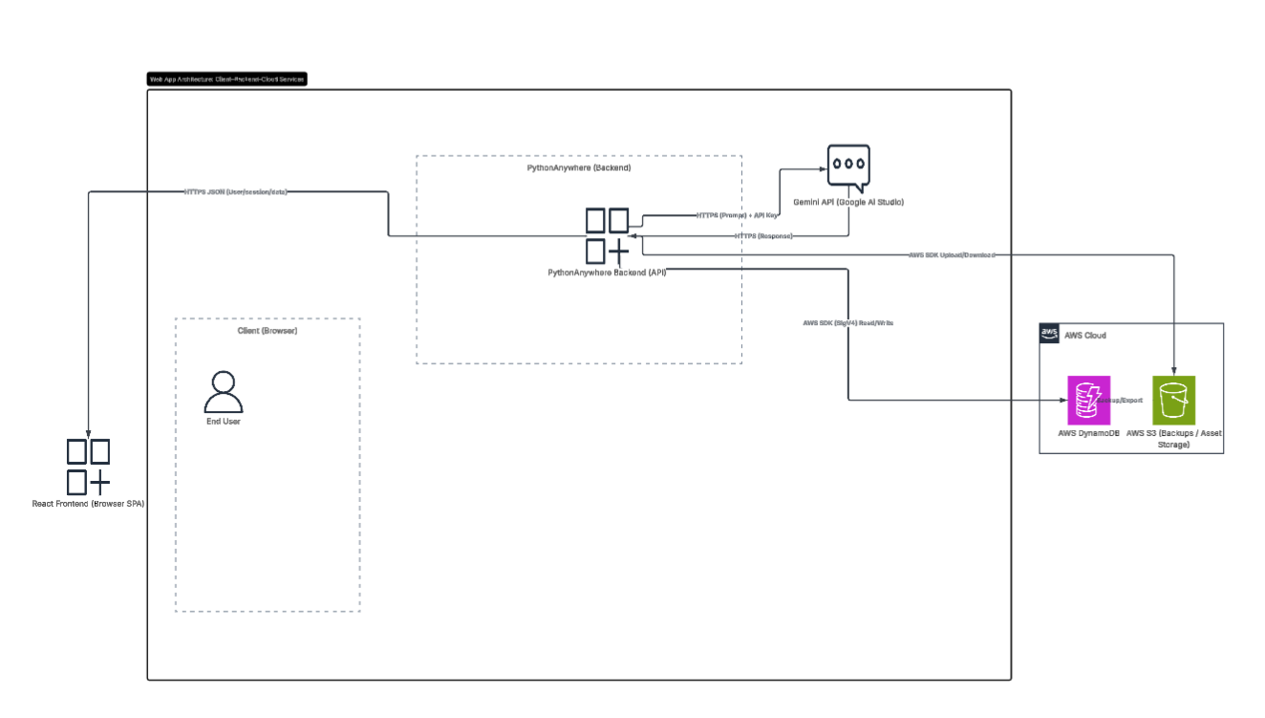
Systems Architecture
Notes:
Charles

Slide 12
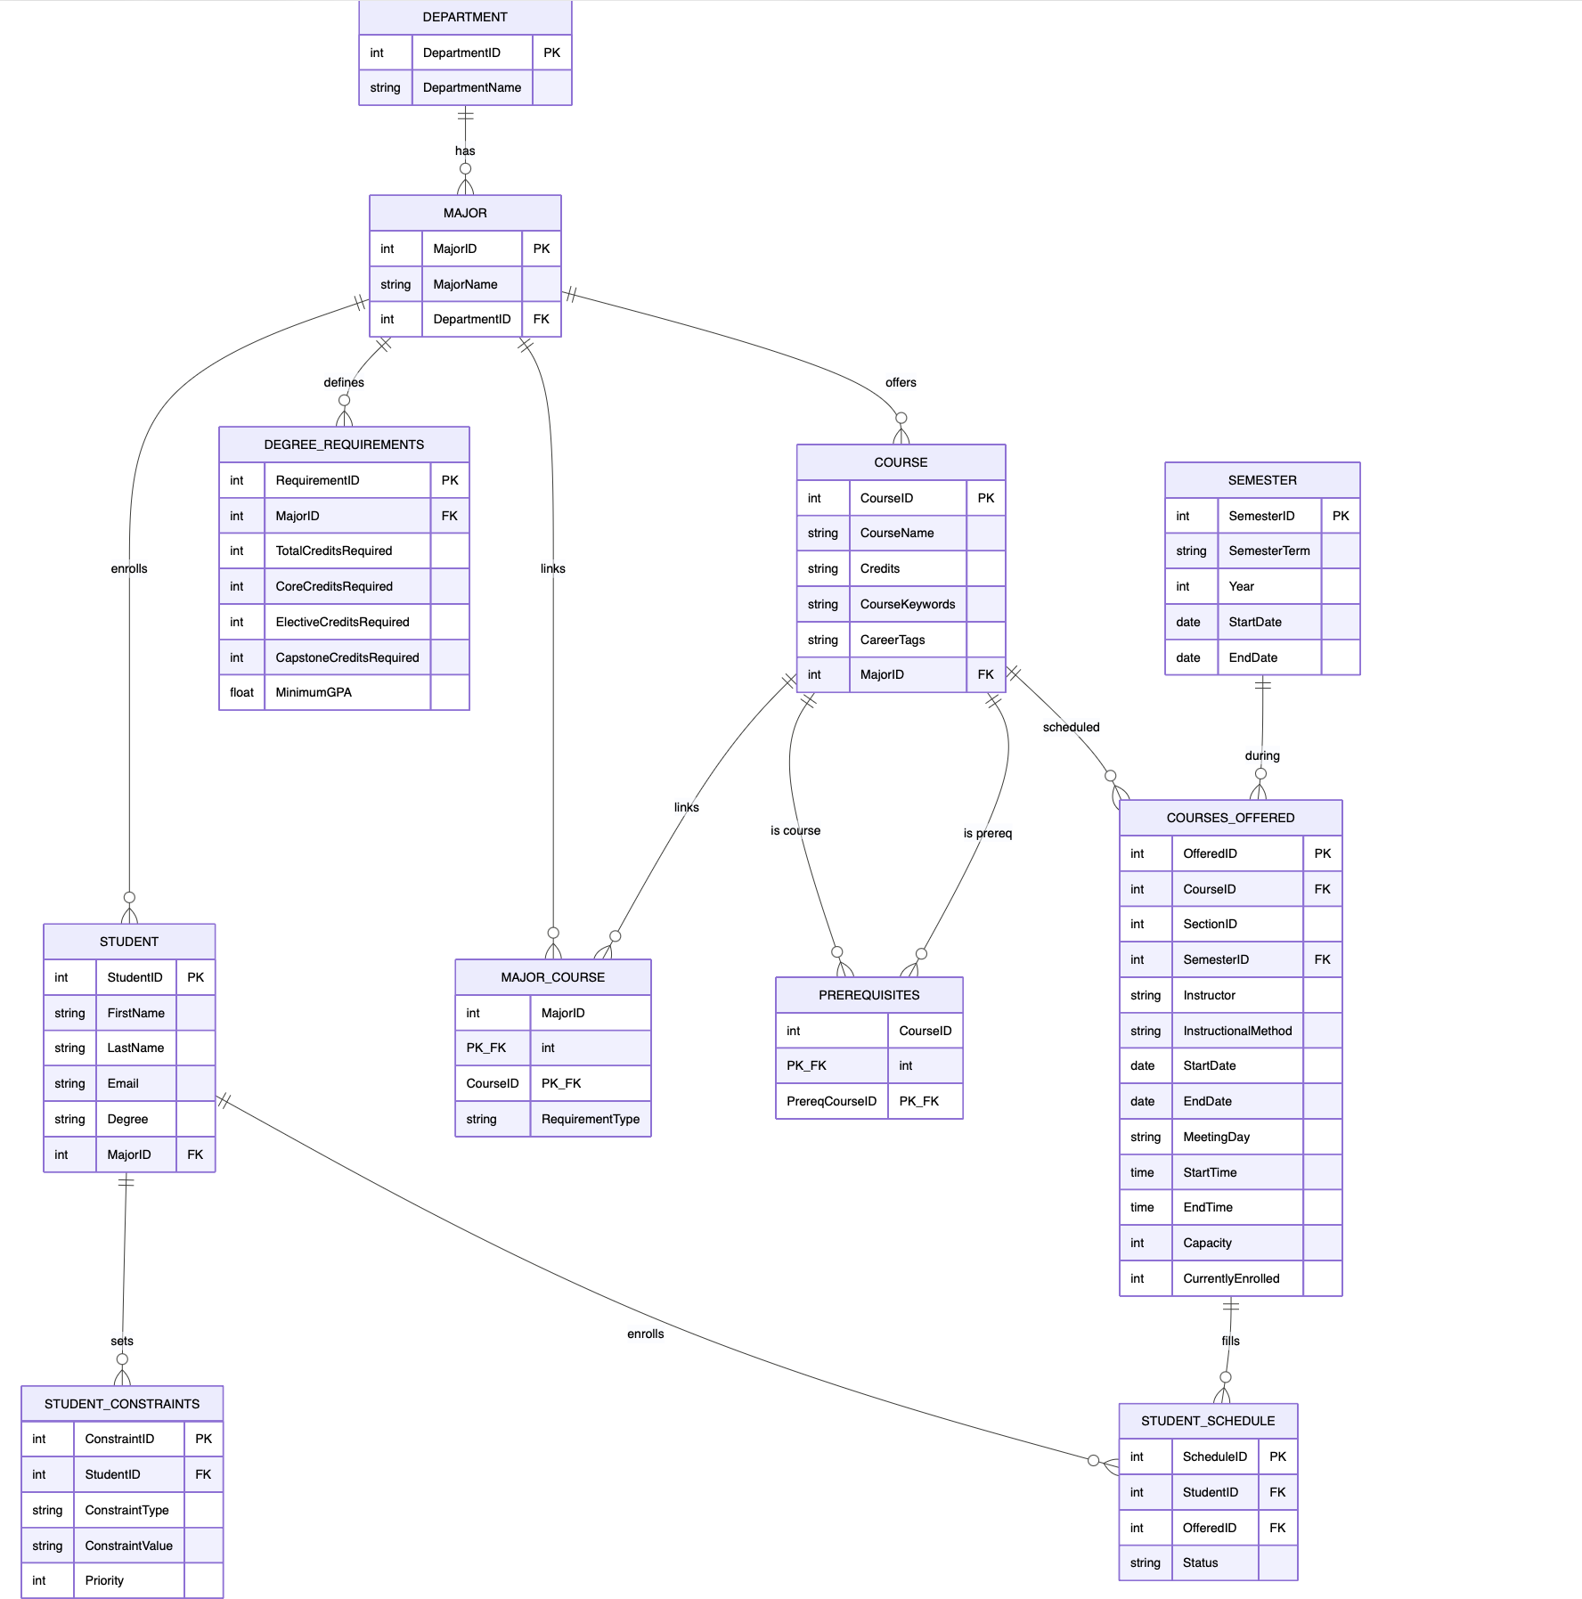
Database Design
Notes:
Anndeen

Slide 13
Sprint 1 Recap
Frontend, Backend, Database and AI were created but not connected.
Team was still taking care of some planning tasks for Sprint 0 (User stories to get started on coding)
Notes:
James

Slide 14
Product & Sprint 2 Backlog
There is no product backlog for Sprint 2. All tickets/cards on the Kanban board were closed. The only case that carried over from Sprint 1 ended up getting scrapped as a poorly-created ticket/user story (James).

Slide 15
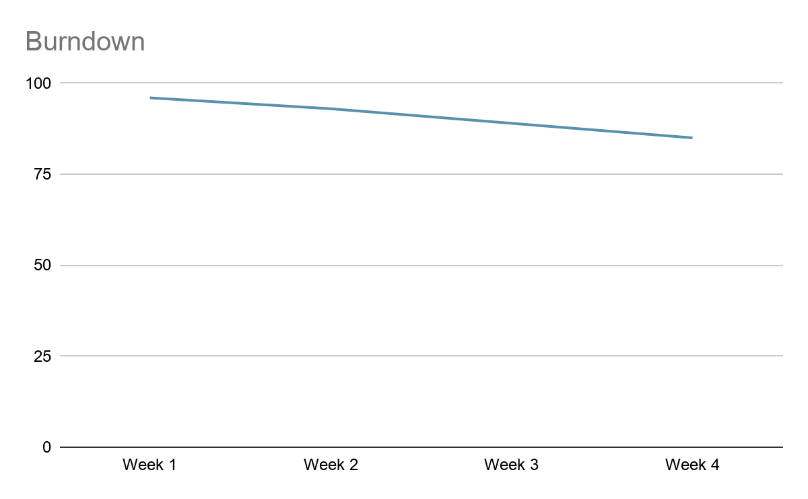
Sprint 1 Summary
Major Tasks & Stories
Frontend and Backend were created
Database and AI provisioned and set up.
The parts were not connected yet.
Notes:
James

Slide 16
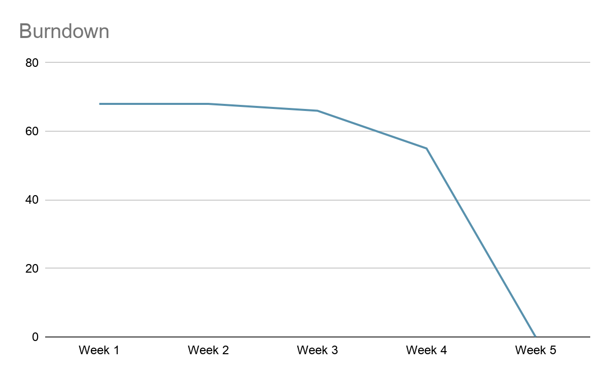
Sprint 2 Summary
Major Tasks & Stories
Frontend, Backend, AI and Database connected and working.
MVP delivered and created (https://2026-paceu-capstone.github.io/intelligent-academic-path-optimizer)
User and Deployment Manuals, Technical Paper and Wiki finished.
Notes:
James

Slide 17
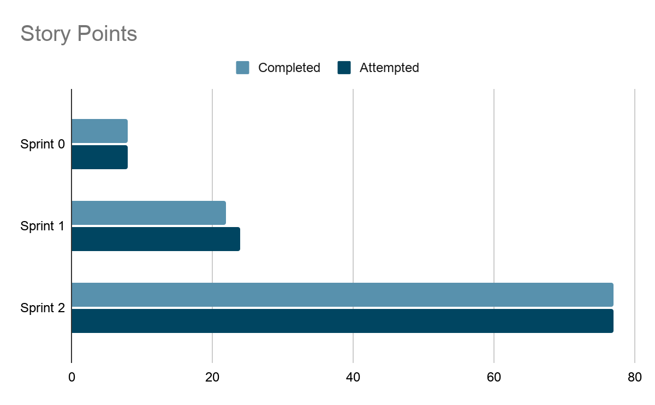
Team Velocity
Average Velocity for Sprints 1 & 2: 49.5 Story Points
Completed/Committed Ratios
Sprint 1 | 22/24 or 91%
Sprint 2 | 77/77 or 100%
Avg. for both Sprints | 95.5%
Notes:
James

Slide 18
Sprint 2 Burndown
Notes:
James

Slide 19
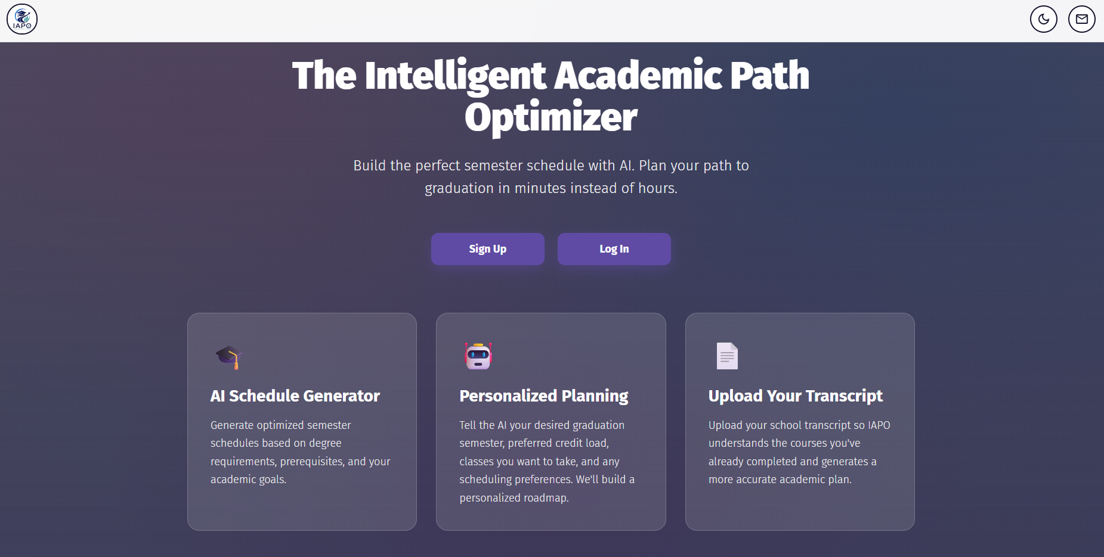
Demos
Notes:
Tara

Slide 20
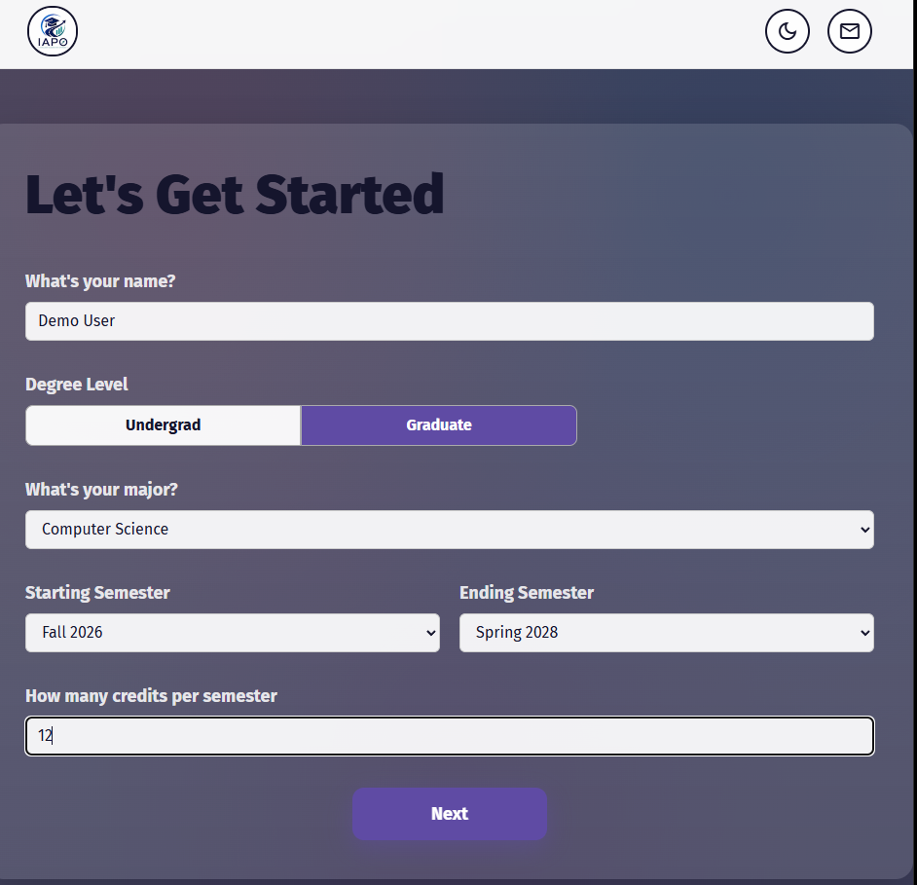
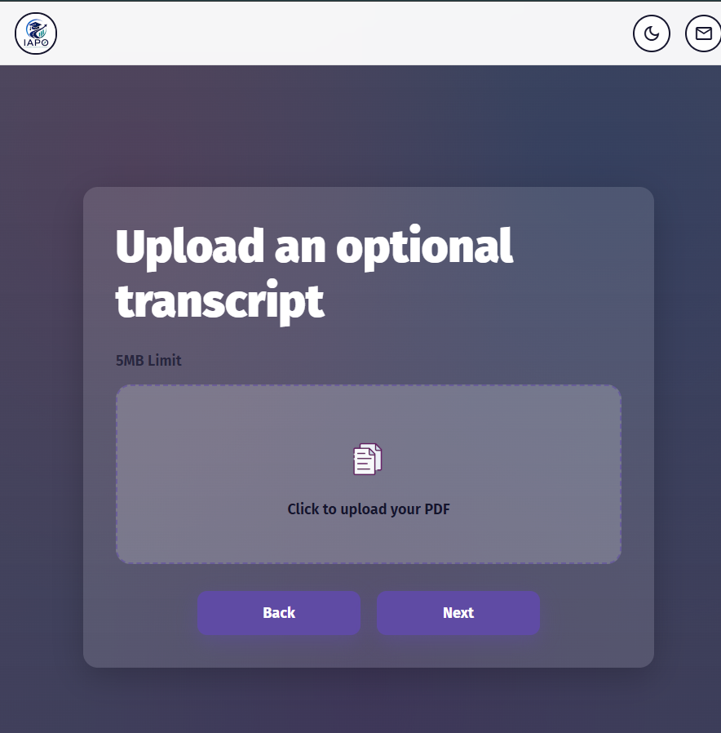
Sprint 2 Demo - Initial Info
Notes:
Charles

Slide 21
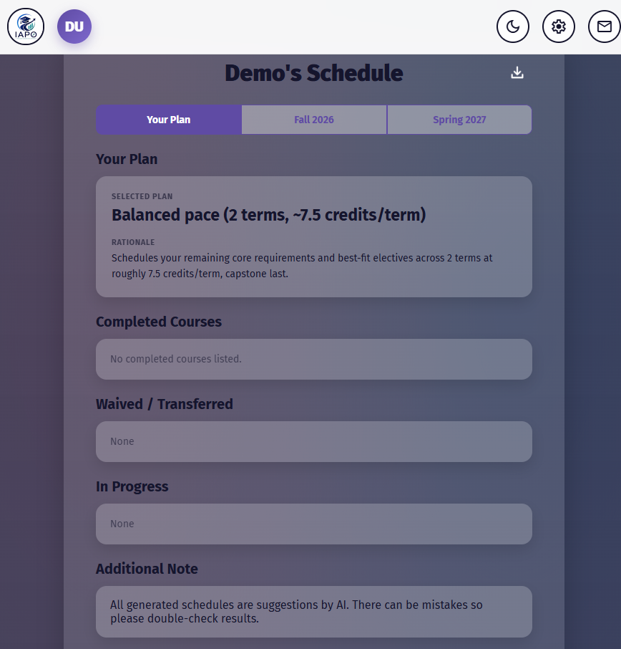
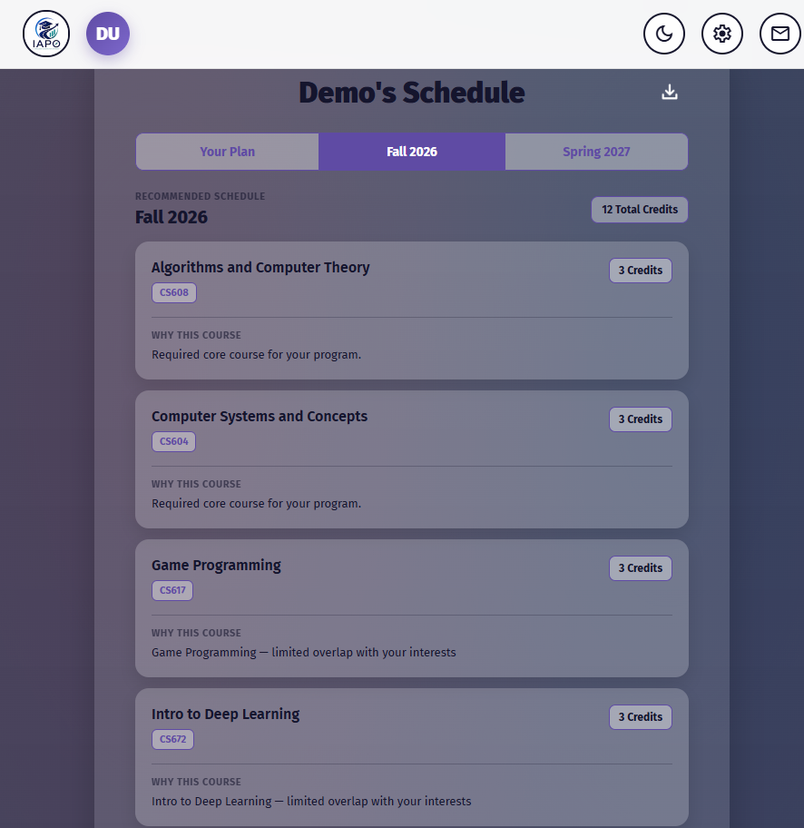
Sprint 2 Demo - Output
Notes:
Younnes

Slide 22
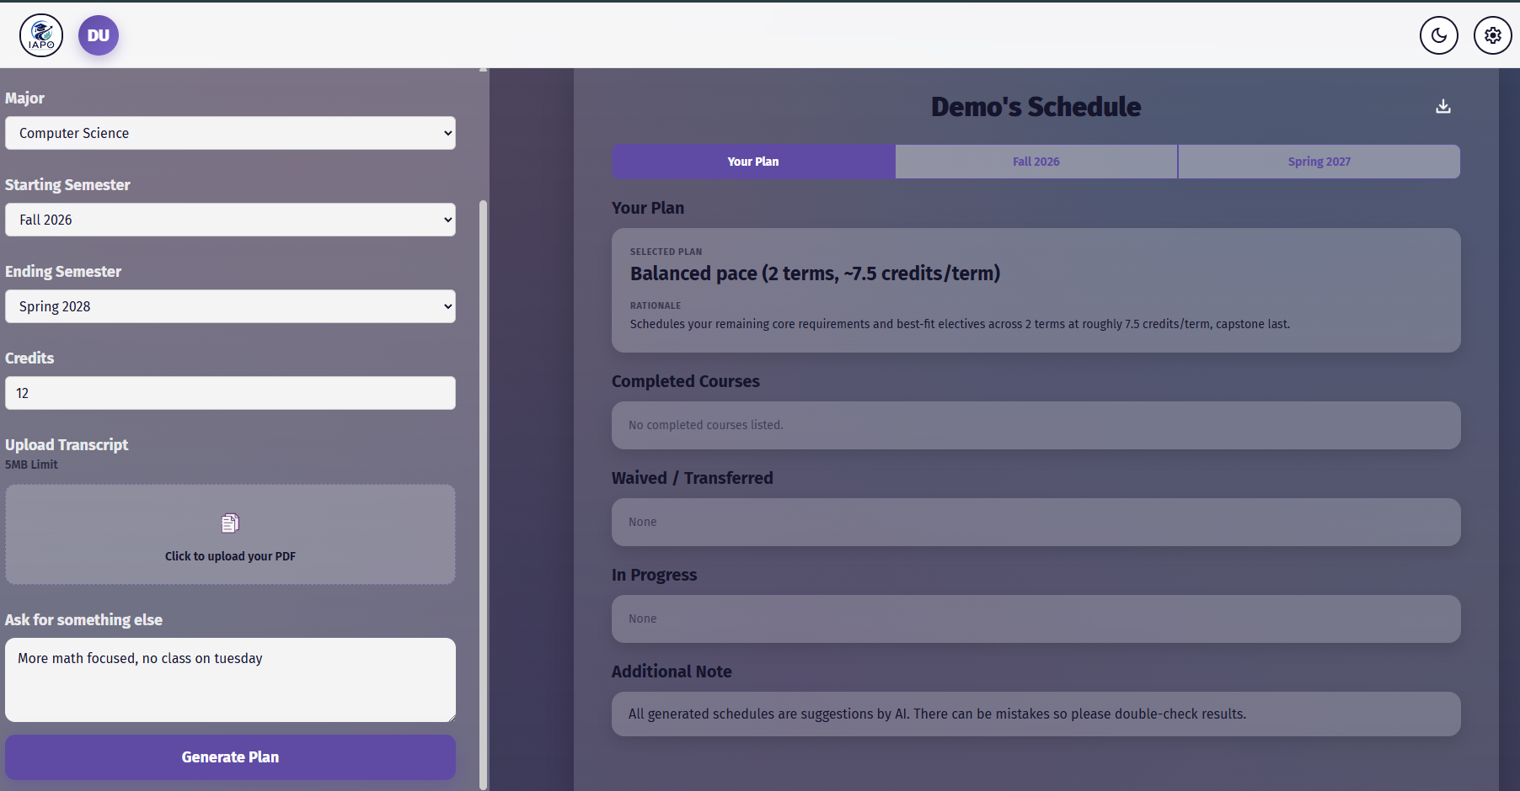
Sprint 2 Demo - AI Output
Notes:
Bella

Slide 23
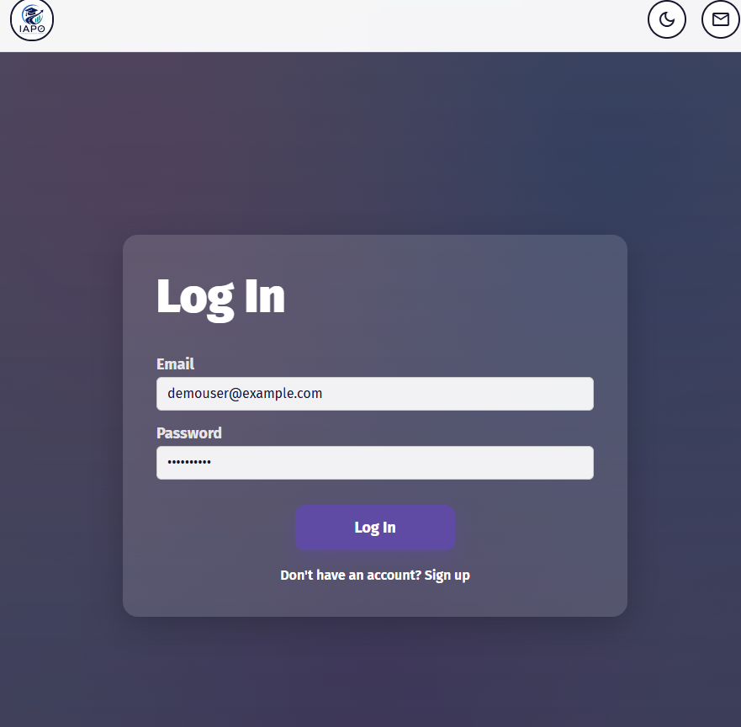
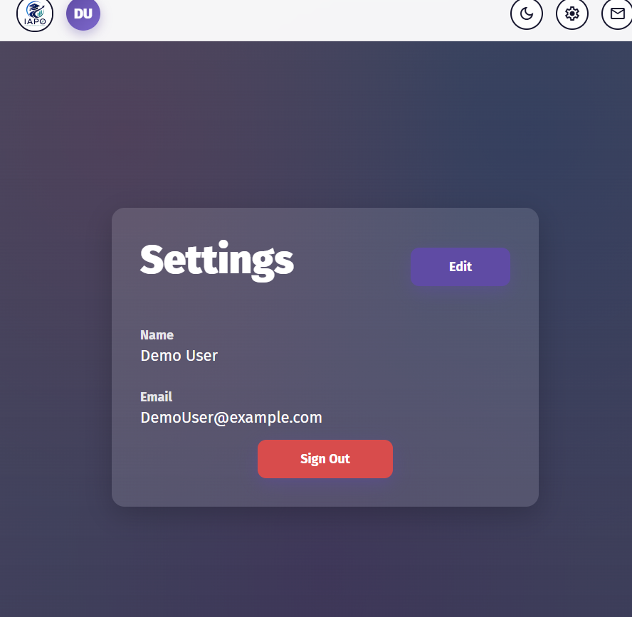
Sprint 2 Demo - Log In
Notes:
Anndeen

Slide 24
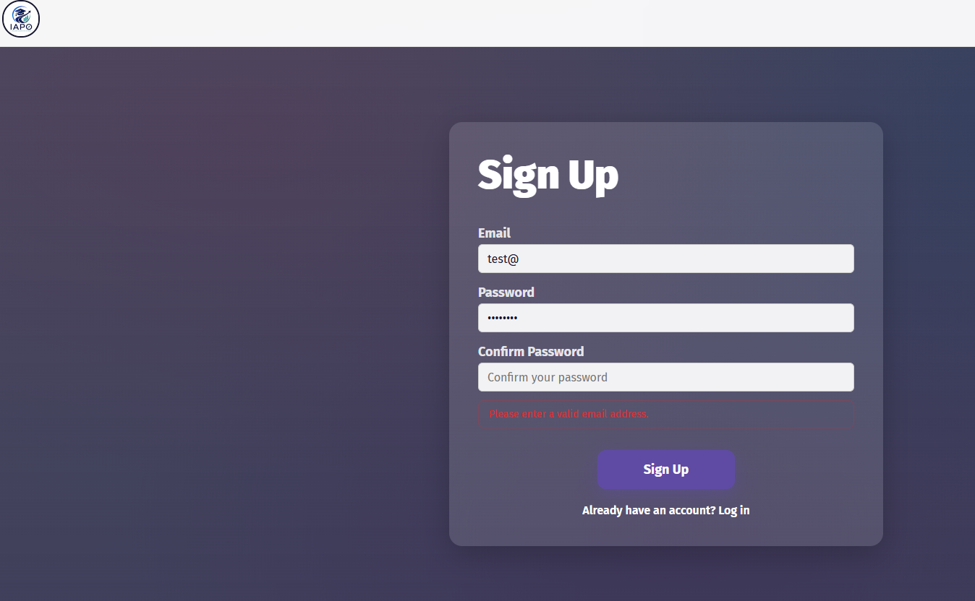
Sprint 2 Demo - Sign Up
Notes:
James

Slide 25
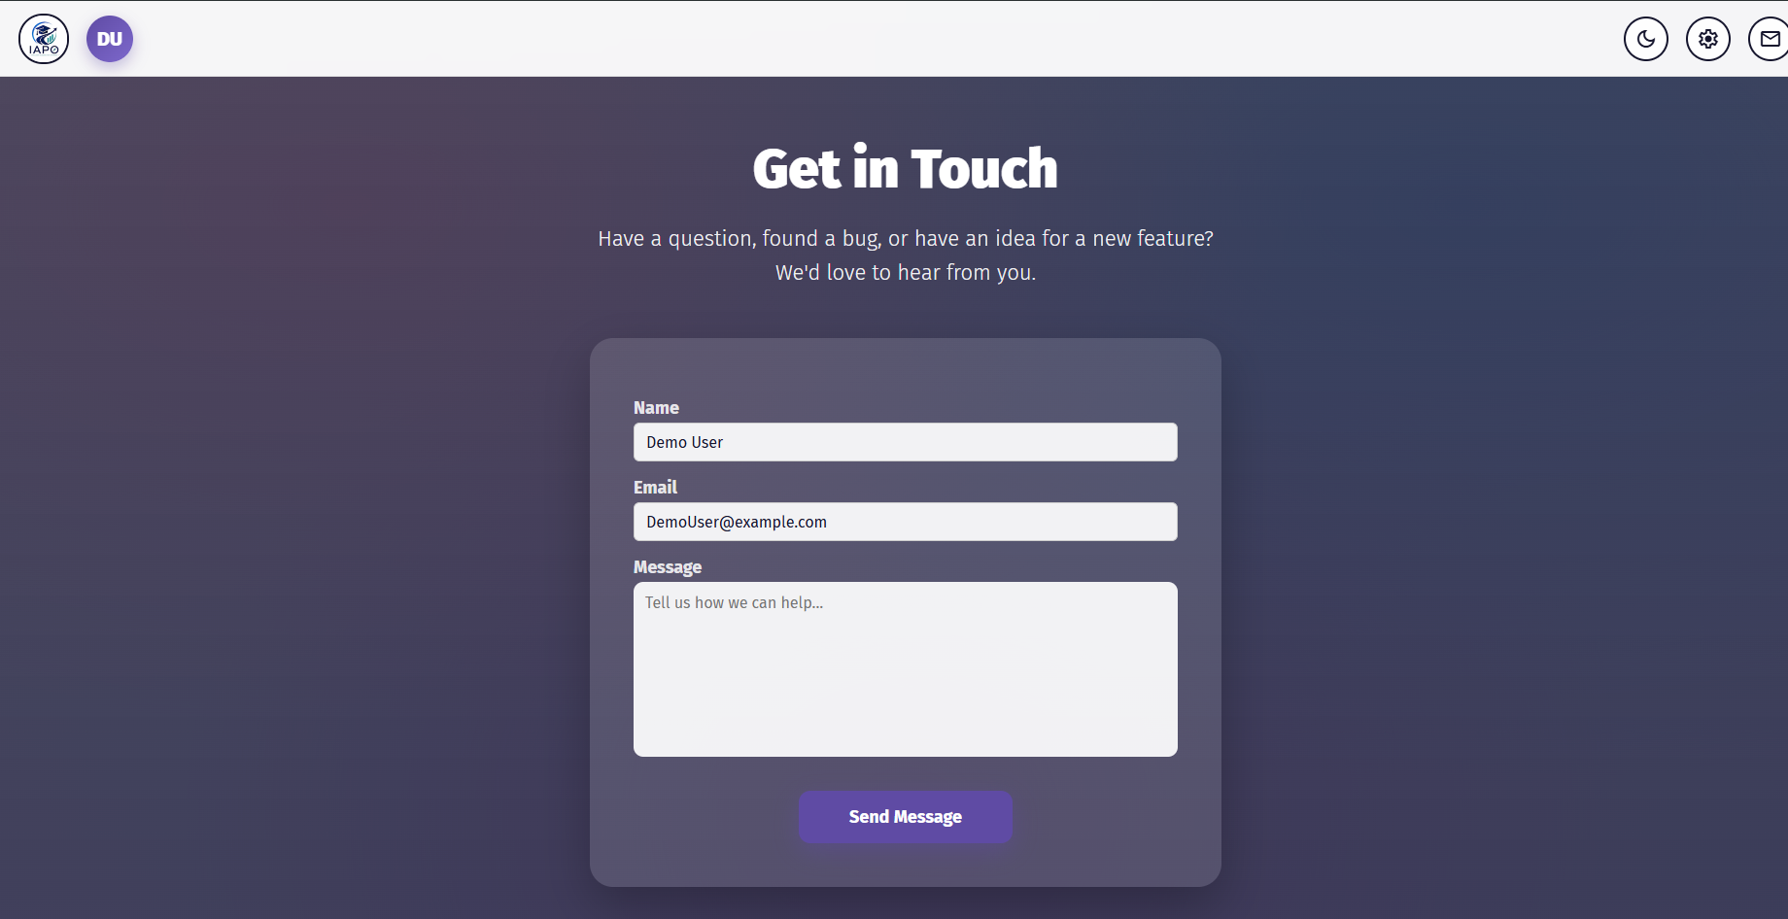
Sprint 2 Demo - Contact Us
Notes:
Tara

Slide 26
Sprint 2 Demo - API
Backend:
GET/auth - Sends a request to confirm if the user has a valid session cookie. This allows them to automatically login on the same browser if they closed the site or returned to it within 7 days.
POST/auth/email - Used during signup for confirming if a user account already exists, so that the same email can’t be used for two different accounts.
POST/signUp - Used for creating the user account
POST/signIn - Used for logging into an existing account.
POST/signOut - Signs the user out and deletes the current session cookies from the user and the database, requiring them to log back in to use IAPO.
POST/updateUser - Used for updating user credentials (Name, email, password)
POST/updateUser/academic - Used for updating user academic details (transcript, major, credits per semester, schedule, etc.)
GET/api/info - Gets the current program info for available majors and semesters
AI:
GET/api/ health - Confirms the service is running, whether the Gemini API key is configured, and if the course catalog is successfully loaded
POST/api /extract - Accepts the frontend field data and returns a JSON object containing course plan recommendations to be handed to the solver
POST/api/transcriptCheck - Accepts a PDF that is checked by Gemini to see if it is a valid transcript or not
Notes:
Younnes

Slide 27
AI DISCLOSURE - James
What?
Gemini
How?
Advice on Agile, assistance with code
Why was this the right tool?
Gemini provides good code assistance and project organization within the platform.

Slide 28
AI DISCLOSURE - Bella
What?
Claude
How?
Generating all code
Brainstorming for - personas, user stories, acceptance criteria, and test cases. Also to create these documents after I told it the text to include.
Why was this the best solution?
This was a complex project far past my coding capabilities and I knew Claude could write efficient and accurate code.
So that I could learn these new concepts and work with the ai to expand on ideas. The document creation was in the interest of saving time and to enhance visualisation.

Slide 29
AI DISCLOSURE - Charles
What?
Lucidchart, Claude, and Wispr Flow
How?
Lucidchart was used to generate the systems architecture diagram.
Claude was used to generate the use case diagram and reorganize the wiki page at the beginning of Sprint 2 into a format that facilitates meeting the checklist requirements.
Wispr Flow was used as a dictation tool to write out parts of the MVP write-up, the wiki page, the systems architecture section of the technical paper, and my individual report. It converts human voice to text and primarily serves to increase typing speed (triple it in my case), while correcting minor mistakes and removing filler words.
Why was this the best solution?
Lucidchart had a selection of symbols within its free tier which sufficiently satisfied the requirements to generate the systems architecture diagram via user prompt.
Claude needed diagram symbols that Lucidchart couldn’t generate on its own due to its limited selection of symbols in the free tier. I've also observed it to be the best performing AI for code-related projects, including redesigning wiki pages.
Wispr Flow outperforms most open source dictation tools which run locally.

Slide 30
AI DISCLOSURE - Anndeen
What?
Claude.AI, Chat GPT
How?
Mainly to figuring out how to integrate different tables together to generate results that the backend would understand.
Thinking of more challenges each persona/users might face so the app could account for more real world use cases.
To format multiple item entries that can easily be copy and pasted into the database.
To revise the entity relationship diagram to show the connection between the tables
Why was this the best solution?
To avoid errors and make sure the data matched and tables worked together correctly for the backend and ai layer
Helped catch problems that wouldn't be thought on my own
To save time on repetitive formatting and integration work.

Slide 31
AI DISCLOSURE - Younes
What?
Claude AI, Chat GPT
How?
Used for fixing coding errors in the front and backend
Used for front-end stylization
Why was this the best solution?
They do a good job of finding the root problem for errors, which is hard to see when viewing several scripts with hundreds of lines of code
Not well versed with CSS styles and format, so they were used to design the base site, which was then edited to better fit the application.

Slide 32
AI DISCLOSURE - Tara
What?
Claude
How?
Aid with clean code
Why was this the best solution?
As someone new to coding, especially with a team, it’s hard to know what the typical best practices are

Slide 33
Links
Github: https://github.com/htmw/CS691-Summer2026-Team1/wiki
MVP: https://2026-paceu-capstone.github.io/intelligent-academic-path-optimizer/

